Slide 1

Artist Selection Insights
EILEEN IP
VISULATION PRESENATATION

Slide 2

OUR CLIENT
The Gems Event Management, is Australia’s premier organiser of business and special events specialising in large scale music events featuring top tier artists.
This report is primarily designed for the organisation's executives, event planners, and marketing strategists who rely on data-driven insights to make decisions on artist selection and event planning.

Slide 3
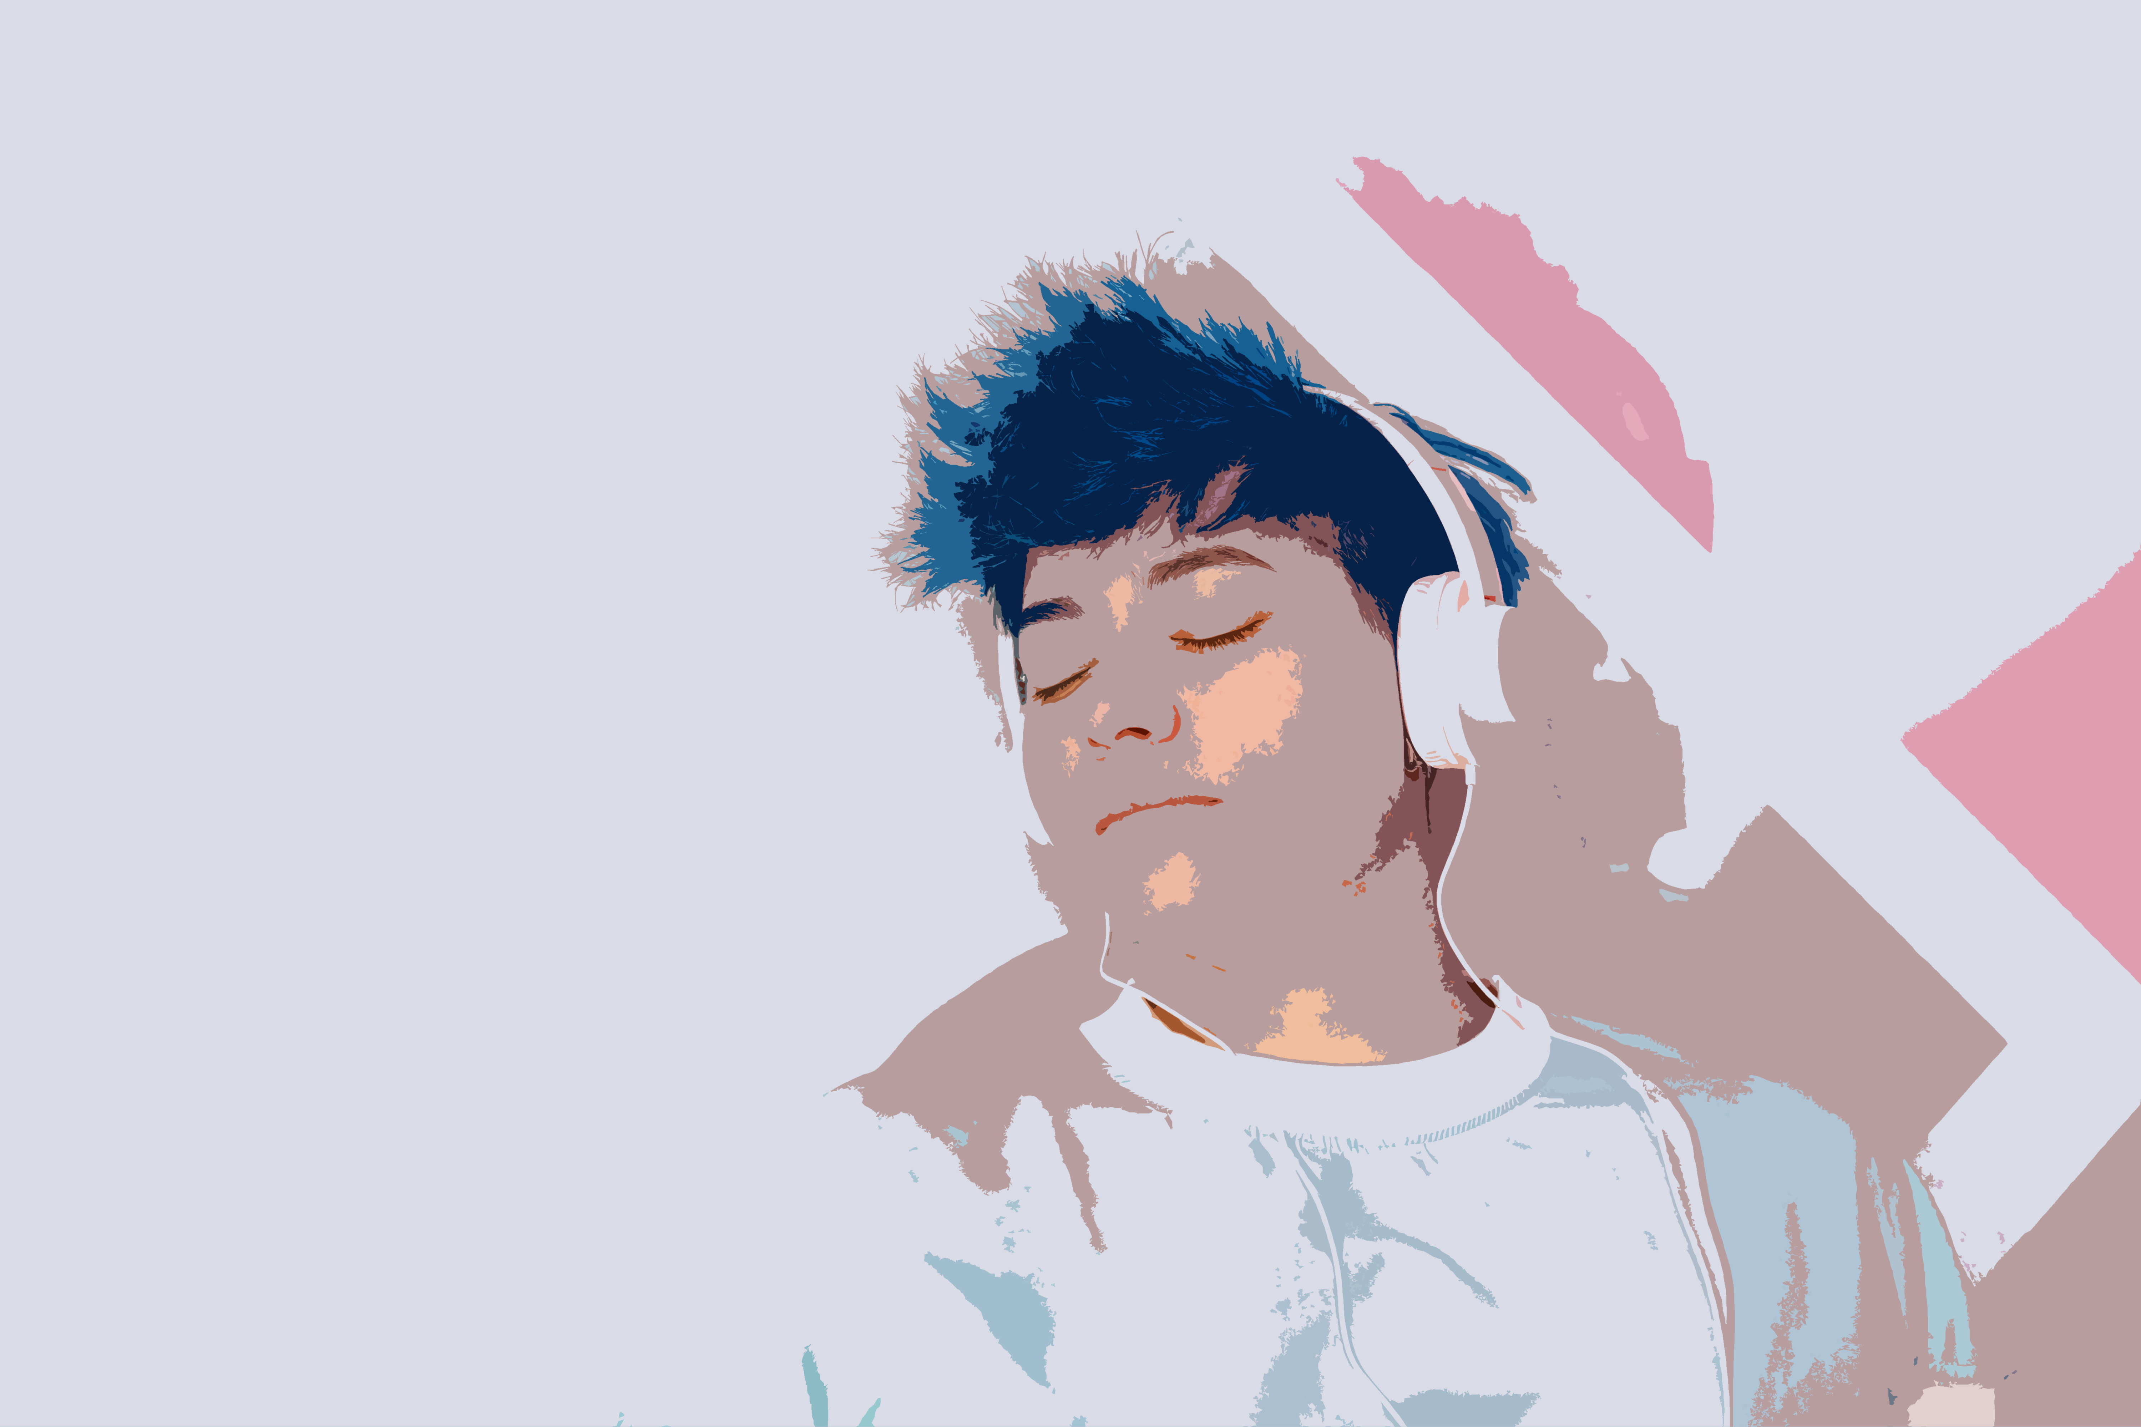
OUR OBJECTIVE
The objective of this report is to enhance audience engagement and satisfaction while maximising concert success by identifying the most popular artists, their top-performing songs and key song features.
Specifically, the report aims to visualise a diverse range of variables, analysing the key trends and offer actionable insights. By conducting this, the report will optimise the artist selection process, artist’s songs recommendation and identify current song features trends.

Slide 4
Variables
 | Why It Matters?
Artist Name | This is the name of the artist, it is important to use because it Identifies artists by name.
Artist Familiarity | The rating of the artist recognition at that given year, this is essential because it measures public recognition of the artist at a given year, indicating popularity awareness.
Artist Hotness | The artist popularity at that given year, this is crucial because it assesses real time popularity trends, helping identify rising or declining stars.
Song Hotness | The popularity of individual songs, which helps gauge the current demand for specific tracks, ensuring setlists feature crowd favourites.
Duration | The duration of the song. This is important since the songs must be under 4 minutes to maintain fair performance time and optimal audience engagement..
End of Fade In, Start of Fade Out, Key, Loudness, Tempo, and Time Signature: | These are the song features in the song. These features are essential to understand because analysing the songs’ formats would help identify their common patterns over the years.
Mode (Major/Minor) | Songs are either in major or minor chord. Prioritising songs in major chords for a brighter, more energetic and engaging sound would boost the experience.
Year | Release year of the song, this is crucial because it tracks artist consistency, helping distinguish fleeting trends from potential talent.

Slide 5
BENEFITS
Selecting the most popular artists ensures high ticket demand, directly impacting revenue potential.
Featuring top artists increases the likelihood of audience enjoyment, engagement and encourages repeat attendance.
Higher audience engagement can attract more sponsors and create valuable brand partnerships.
Gain a competitive edge by leveraging data to identify trends and audience preferences.
The actionable insights found from this project can refine future event strategies, improving artist selections and overall concert experiences.

Slide 6
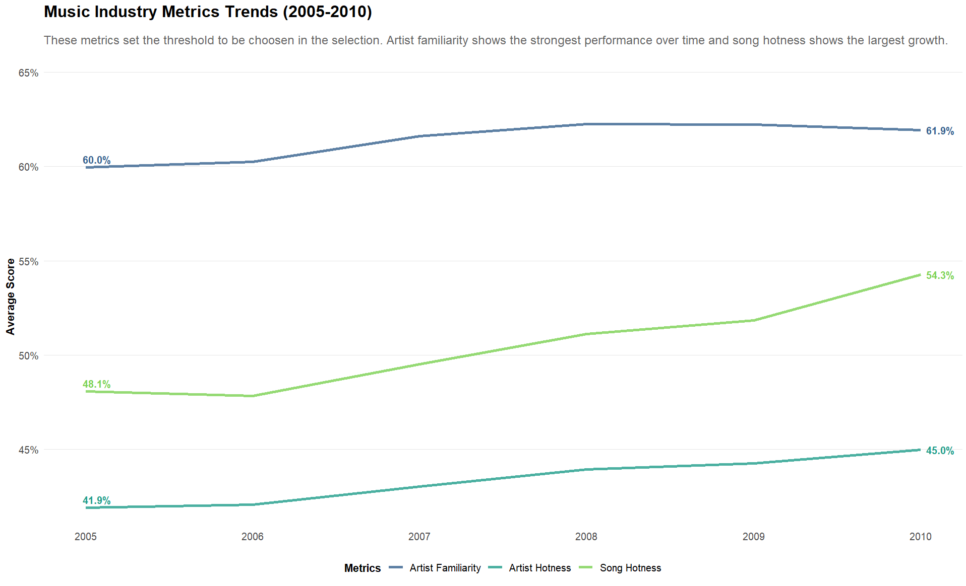
Notes:
Describe the message to share with stakeholders from that plot:
The line plot shows consistent growth in artist familiarity (60.0% to 61.9%), song hotness (48.1% to 54.3%), and artist hotness (41.9% to 45.0%) from 2005-2010. These trends establishes minimum thresholds for artist selection. Artist with high artist familiarity should be prioritised as it is the highest metric, and their songs with the highest song hotness should be considered more because of the rapid growth by 6.2%.
Why is this message will be important for stakeholders:
This visualisation is important because identifying the current standards ensures the artists select are most qualified for this concert. Choosing artists above these averages reduces the likelihood of poor ticket sales or weak audience response. In addition, the growth in these metrics highlights the changes in audience preferences over time, which is critical for staying competitive.
What should stakeholders do as a result of seeing the plot:
Stakeholders should use the latest averages (2010) as minimum criteria for artist shortlisting in this selection process. In addition, they should monitor every year to adjust benchmarks for future events.
Describe what steps taken so that the plot will have the most meaning and impact on stakeholders as possible:
To show find the current music standards, group the dataset by year, and extracted the averages of artist familiarity, artist hotness and song hotness.
Visualise data using a line plot average score by year to identify the patterns and matches the colours with the company’s colour scheme to enhance the appearance.
Changed the average score from decimal to percentage, and add labels on the lines, to highlight the rise of the scores.
For this key feature identified in the plot, describe how this feature links back to the main project:
These ratings directly supports the project’s goal of selecting the top artists by setting requirements to identify the qualified artists which ensures strong audience engagement and event success.

Slide 7
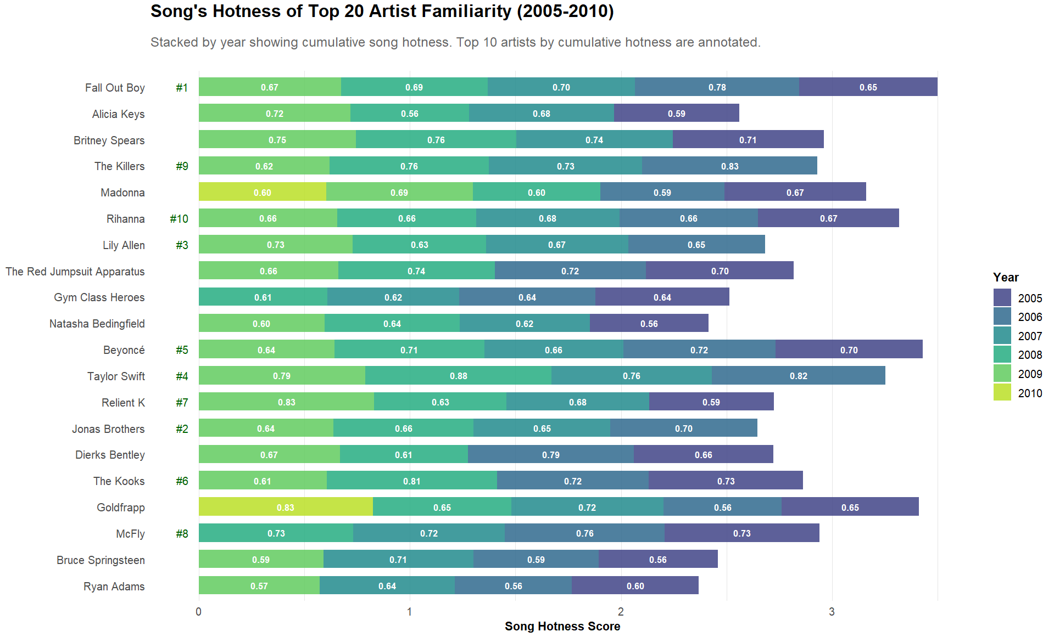
Notes:
Describe the message that you want to share with stakeholders from that plot:
This stacked bar plot identifies the top 20 artists ranked by artist familiarity; color coded by year to show their cumulative song hotness. The top 10 artists (highlighted text) represent the safest and highest impact picks based on the combination of strong brand recognition with a consistent history of hit songs.
Why is this message will be important for stakeholders:
This plot is important as it shows the top 10 artists have both high familiarity and high song hotness, reducing the chance of selected artists who are recognisable but lack recent hits and consistency. Fans are more likely to attend when they know both the artist and their songs. In addition, the ranking eliminates subjective bias because of the use of historical data to guide the decision making.
What should stakeholders do as a result of seeing the plot:
Stakeholders should focus negotiation efforts and budgets on the highlighted artists, because they offer the best advantages. Artists that are not in the top ten should be considered as substitutes if the selected artists are unavailable.
Describe what steps taken so that the plot will have the most meaning and impact on stakeholders as possible:
To show find the best artists, group the dataset by year and artist name, extracted the averages of artist familiarity and song hotness, filter top 20 artists with 4+ songs by average artist familiarity.
To identify which artists to select, filter and group by artist name, extract sum of song hotness, reorder sum of song hotness to be in descending order, create rank with row number and boolean column to highlight the top 10 ranks.
Visualise data using a stacked bar plot by cumulative song hotness and artist names, stacking each artist’s song by year. The plot matches the colours with the company’s colour scheme to enhance the appearance.
Added song hotness label on each stack to show the song hotness scores of each artist and a ranking label to highlight which artist to select based on the highest cumulative song hotness.
For this key feature identified in the plot, describe how this feature links back to the main project:
This plot directly addresses the project’s goal of selecting best artists by prioritising the best artists by artist familiarity and their song by hotness. This ensures the concert delivers the highest sales and engagement.

Slide 8
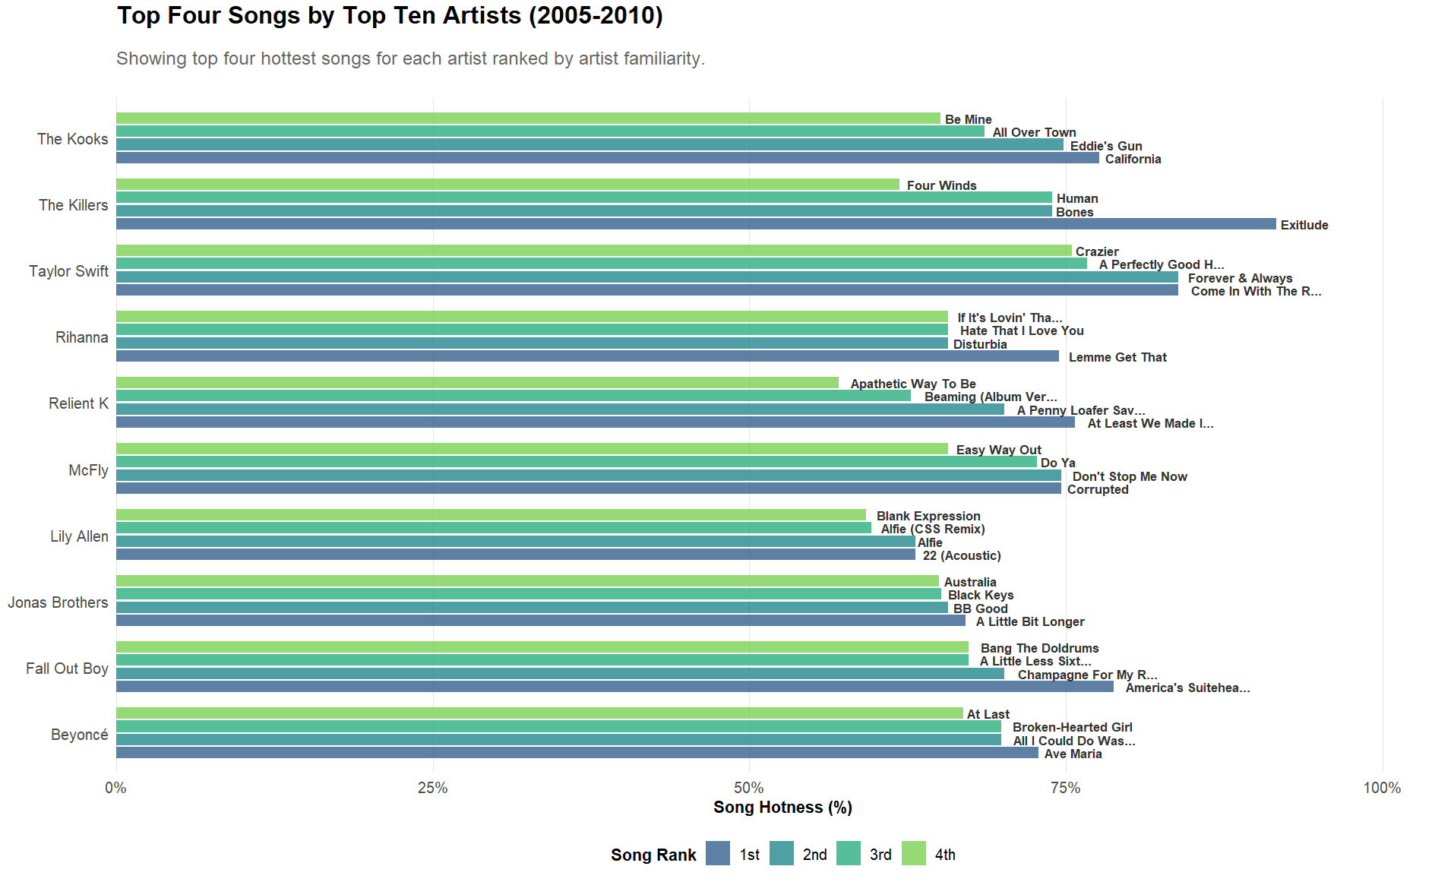
Notes:
Describe the message that you want to share with stakeholders from that plot:
This bar plot displays the top 4 songs with the highest hotness for each of the 10 selected artists. This provides clear guidance for optimal setlist selection.
Why is this message will be important for stakeholders:
This visualisation is crucial because it shows the recommended songs that artists should prioritise them in their performances which would help maximise crowd response and event success. This information provides artists to focus on their most impactful tracks and eliminates guesswork.
What should stakeholders do as a result of seeing the plot:
Stakeholders should provide this data to the 10 selected artists to guide their setlist decisions. In addition, stakeholders should create marketing strategies of the highlighted tracks to build anticipation and ticket sales.
Describe what steps taken so that the plot will have the most meaning and impact on stakeholders as possible:
To show find the best artists, group the dataset by year and artist name, extracted the averages of artist familiarity and song hotness, filter top 20 artists with 4+ songs by average artist familiarity.
Visualise the data using a correlation matrix by the song features. The plot matches the colours with the company’s colour scheme to enhance the appearance.
Added song hotness label on each stack to show the song hotness scores of each artist and a ranking label to highlight which artist to select based on the highest cumulative song hotness.
For this key feature identified in the plot, describe how this feature links back to the main project:
This plot directly supports the project’s goal of selecting the best songs for each artist by showing their best four songs to perform reduces risk of low engagement and ensures the overall attendee experience improves.

Slide 9
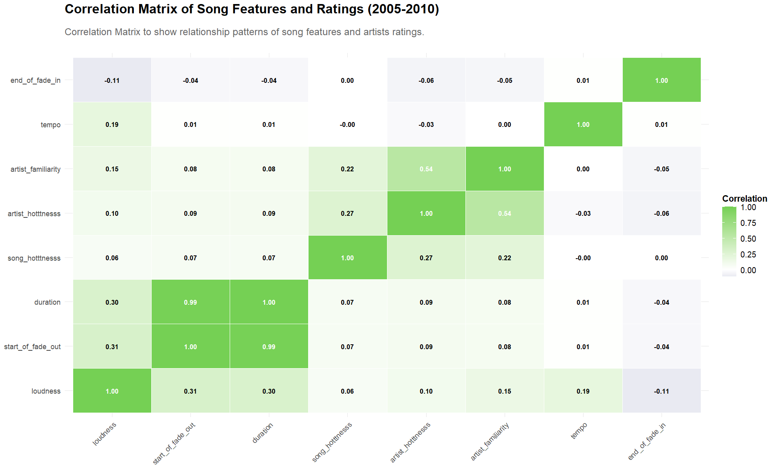
Notes:
Describe the message that you want to share with stakeholders from that plot:
This correlation matrix reveals the relationships of the song features. The only relevant relationship between duration and start of fade is strongly positive. Most of the correlations are either weak (below 0.50) or are unrelated to each other.
Why is this message will be important for stakeholders:
This matrix is important to know because it shows the technical elements that statistically correlate with successful songs. This ensures the songs selected are highly engaging which helps with the overall success of the concert.
Describe what steps taken so that the plot will have the most meaning and impact on stakeholders as possible:
To show find the correlation between variables, select all the neumic columns, creating a correlation matric, reorder the matric and reduced the size of the correlation.
Visualise data using a correlation matrix plot by analysing correlations of the song features. The plot matches the colours with the company’s colour scheme to enhance the appearance.
For this key feature identified in the plot, describe how this feature links back to the main project:
This directly advances the goal of informing artists about the latest relationships of the song features used by other artists above the threshold, by helping artists to create or choose songs based on these correlated features would ensure the songs performed are high engaging.

Slide 10
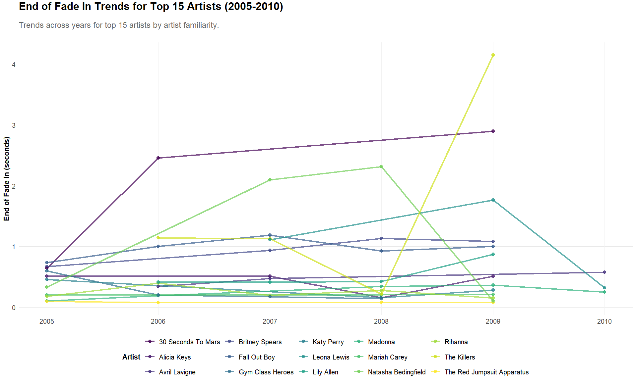
Notes:
Describe the message that you want to share with stakeholders from that plot:
This line plot reveals a clear, consistent trend among the top 15 most familiar artists use of end of fade in. Most of the songs use a 0-1 second as end of fade in time.
Why is this message will be important for stakeholders:
This is important because knowing the standards of the most suitable end of fade in would contribute to commercial success, providing a strong recommendations for artists.
What should stakeholders do as a result of seeing the plot:
Stakeholders should share this insight with the selected artists, recommending they apply 0-1s fade-ins to new or existing songs.
Describe what steps taken so that the plot will have the most meaning and impact on stakeholders as possible.
To show find the trends of end of fade in over the years, group the dataset (containing top 20 artists, and their songs’ features) by artist name, extracted the mean of artist familiarity and end of fade in of each year, and filter the top 15 artists.
Visualise the data using a line plot by the end of fade in and years, the artists are categorised by colour. The plot matches the colours with the company’s colour scheme to enhance the appearance.
For this key feature identified in the plot , describe how this feature links back to the main project:
This directly supports the goal of providing guidance of the best feature adjustments which ensures their songs performed results in high engagement.

Slide 11
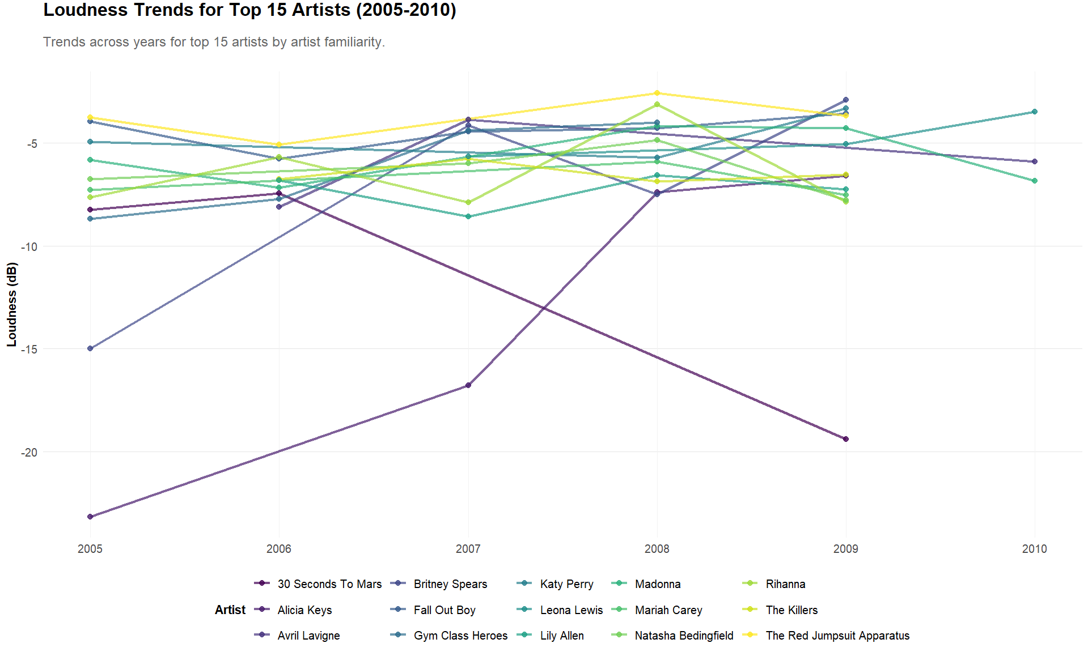
Notes:
Describe the message that you want to share with stakeholders from that plot:
This line plot demonstrates that the top 15 most familiar artists consistently. Most of their songs maintain loudness levels between -4dB to -8dB in their music over the years.
Why is this message will be important for stakeholders:
This is essential for stakeholders because it shows that the most recognisable artists who align with this trend can ensure their music stands up to current industry standards.
What should stakeholders do as a result of seeing the plot.
Stakeholders should recommend the selected artists to prioritise between -4dB to -8dB loudness towards their new and existing songs.
Describe what steps taken so that the plot will have the most meaning and impact on stakeholders as possible.
To show find the trends of loudness over the years, group the dataset (containing top 20 artists, and their songs’ features) by artist name, extracted the mean of artist familiarity and loudness of each year, and filter the top 15 artists.
Visualise the data using a line plot by the loudness and years, the artists are categorised by colour. The plot matches the colours with the company’s colour scheme to enhance the appearance.
For this key feature identified in the plot , describe how this feature links back to the main project.
This analysis directly supports the project’s goal of suggesting the best features which ensures the selected artists’ song meets proven loudness standards for maximum crowd impact.

Slide 12
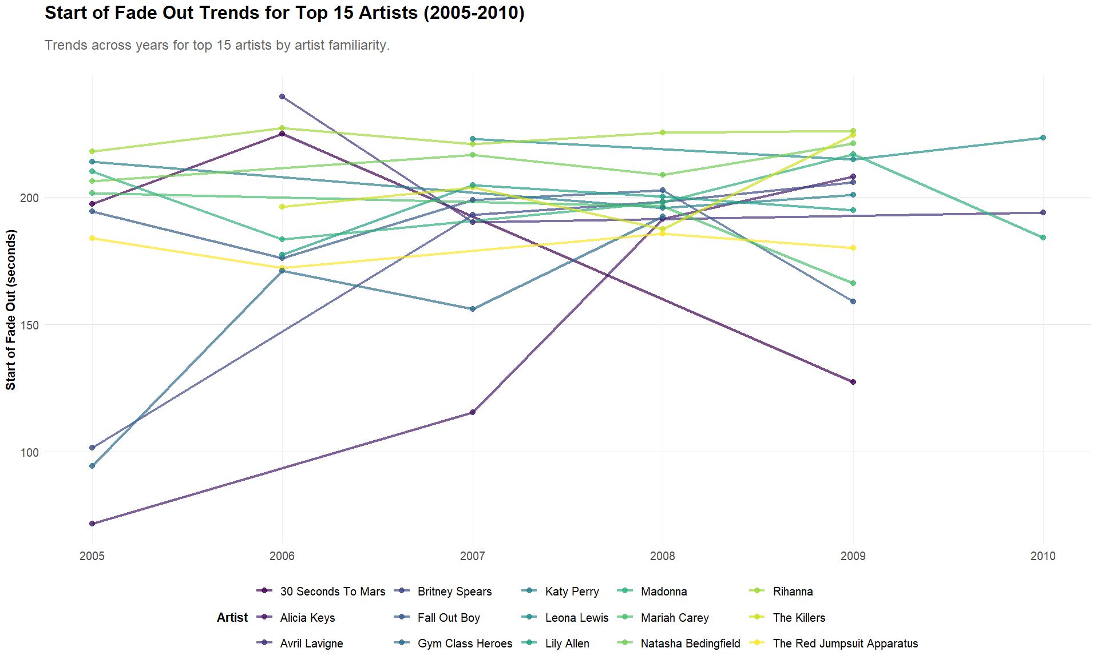
Notes:
Describe the message that you want to share with stakeholders from that plot:
This line plot showcases start of fade out grows in variety over the years among the top 15 most familiar artists. Most of the songs consistently maintained start fade outs starting between 225s-175s in 2005, the range expanded to 150s-225s by 2010, showing a clear industry shift toward earlier fade-outs over time.
Why is this message will be important for stakeholders:
This is important because it provides artists with a guideline for optimising song endings to match modern listener preferences. This ensures the songs produces commercial success and high engagement.
What should stakeholders do as a result of seeing the plot:
Stakeholders should suggest artists to use start of fade outs between 150s-225s in their songs.
Describe what steps taken so that the plot will have the most meaning and impact on stakeholders as possible:
To show find the trends of start of fade out over the years, group the dataset (containing top 20 artists, and their songs’ features) by artist name, extracted the mean of artist familiarity and start of fade out of each year, and filter the top 15 artists.
Visualise the data using a line plot by the start of fade out and years, the artists are categorised by colour. The plot matches the colours with the company’s colour scheme to enhance the appearance.
For this key feature identified in the plot , describe how this feature links back to the main project:
This analysis directly supports the project’s goal of recommending the best features adjustments, which helps maximise audience engagement.

Slide 13
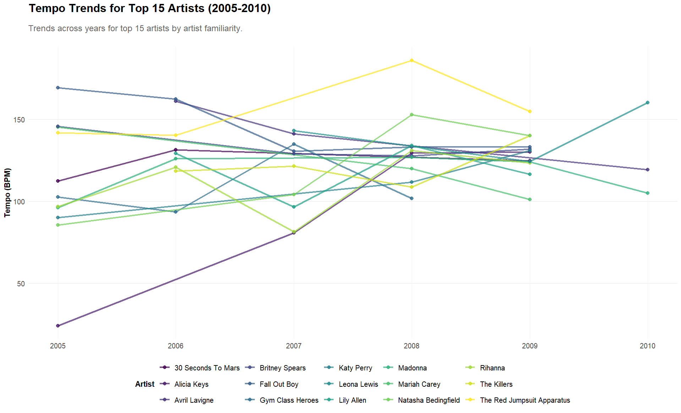
Notes:
Describe the message that you want to share with stakeholders from that plot:
This line plot reveals that the top 15 most familiar artists narrows the variety of tempos over the years. Their songs used to be between 75-150 BPM, recently changes to 100-150 BPM.
Why is this message will be important for stakeholders:
This is important because it provides artists the understanding the currents trends of tempo which boosts live performance energy.
What should stakeholders do as a result of seeing the plot:
Stakeholders should recommend to the selected artists to have their songs between 100-150 BPM.
Describe what steps taken so that the plot will have the most meaning and impact on stakeholders as possible:
To show find the trends of tempo over the years, group the dataset (containing top 20 artists, and their songs’ features) by artist name, extracted the mean of artist familiarity and tempos of each year, and filter the top 15 artists.
Visualise the data using a line plot by the tempo and years, the artists are categorised by colour. The plot matches the colours with the company’s colour scheme to enhance the appearance.
For this key feature identified in the plot , describe how this feature links back to the main project:
This directly helps the goals of suggesting the best adjustments of tempo which maximises audience engagement.

Slide 14
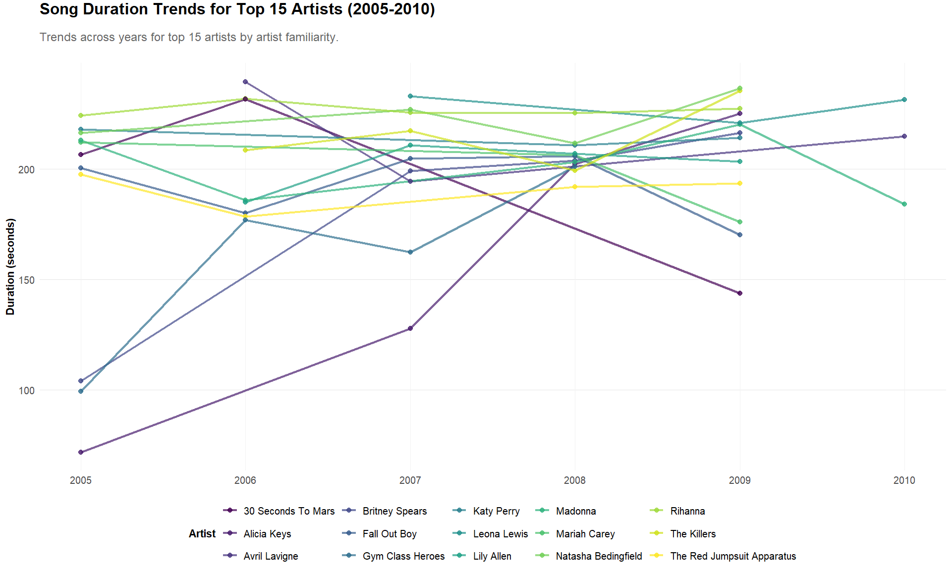
Notes:
Describe the message that you want to share with stakeholders from that plot:
This line plot reveals a significant industry shift in song duration preferences. Top artists used to use 200-225 second in 2005, but over the years, their durations expanded to 150-225 seconds by 2010.
Why is this message will be important for stakeholders:
This is important because it helps artists to understand the modern audience preferences of song duration. This ensures the performances maximises audience engagement.
What should stakeholders do as a result of seeing the plot:
Stakeholders should advise artists to trim or extend their songs to be between 150-225 seconds.
Describe what steps taken so that the plot will have the most meaning and impact on stakeholders as possible:
To show find the trends of song duration over the years, group the dataset (containing top 20 artists, and their songs’ features) by artist name, extracted the mean of artist familiarity and song durations of each year, and filter the top 15 artists.
Visualise the data using a line plot by the song duration and years, the artists are categorised by colour. The plot matches the colours with the company’s colour scheme to enhance the appearance.
For this key feature identified in the plot , describe how this feature links back to the main project:
This directly supports the goal of providing the best adjustments for duration which helps boosts crowd satisfaction.

Slide 15
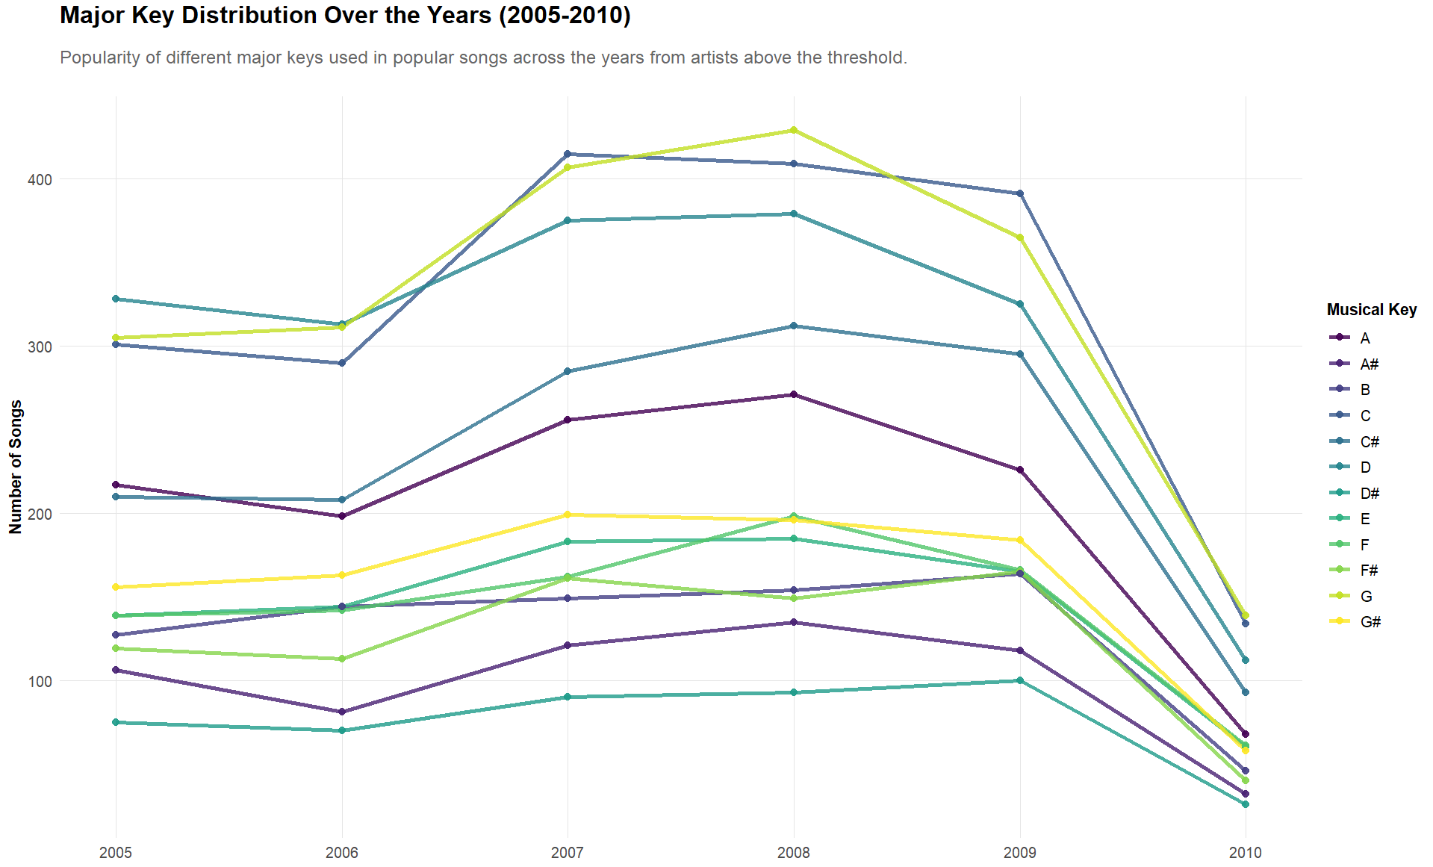
Notes:
Describe the message that you want to share with stakeholders from that plot:
This line plot displays that the top 15 most familiar artists with a consistent distribution trend over time. The data shows that most of songs use major keys C, D and G. The least used keys are D#, F# and A#.
Why is this message will be important for stakeholders:
This is crucial because it provides a clear recommendation for artists to understand and prioritise, to maximise audience appeal and commercial success.
What should stakeholders do as a result of seeing the plot:
Stakeholders should recommend the frequently used major keys to artists to enhance their songs.
Describe what steps taken so that the plot will have the most meaning and impact on stakeholders as possible.
To show find the optimal major key, group the dataset by year and major key, and extracted the frequency of each major keys.
Visualise the data using a line plot by the number of songs and years, the major keys are categorised by colour. The plot matches the colours with the company’s colour scheme to enhance the appearance.
For this key feature identified in the plot , describe how this feature links back to the main project.
This analysis directly supports the goal of suggesting the best feature adjustments, which enhances the listener expectations and boosts engagement.

Slide 16
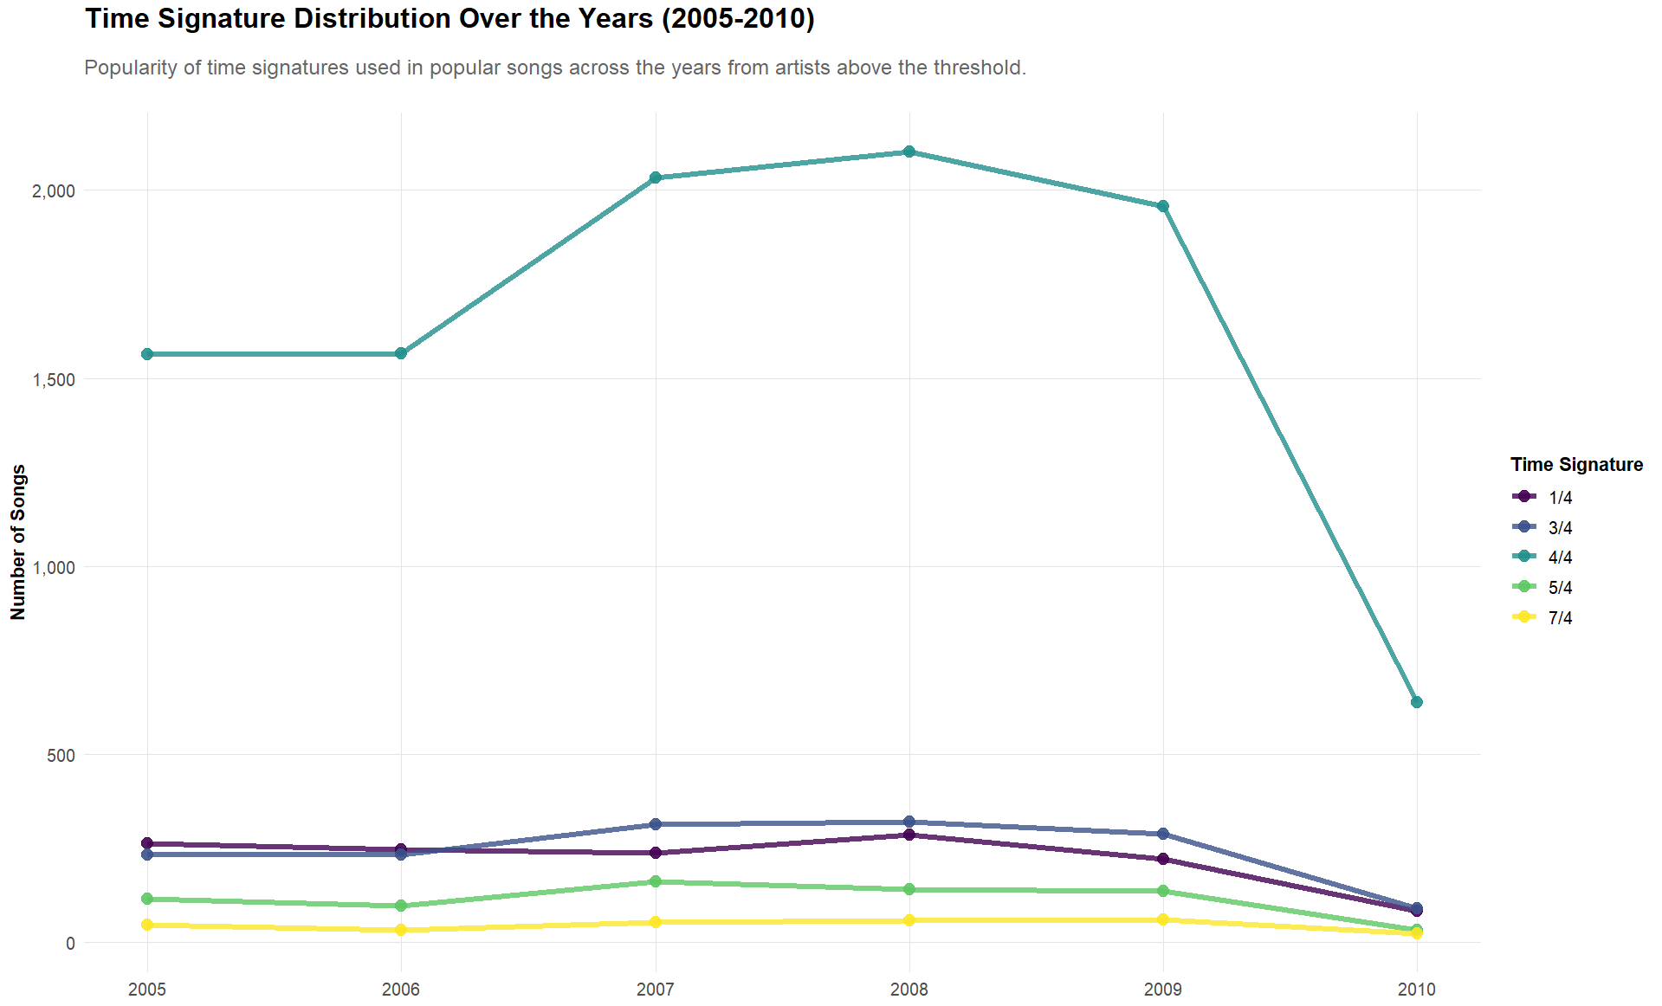
Notes:
Describe the message that you want to share with stakeholders from that plot:
This line plot shows the distribution of time signatures used in songs over the years. To note, around 2000 songs in most of the years were 4/4-time signature while only under 500 songs used the other time signatures across the years.
Why is this message will be important for stakeholders:
This plot is important because it provides information of the current usage of time signatures to artists.
What should stakeholders do as a result of seeing the plot:
Stakeholders should inform these trends to the selected artists when they select or create their songs for the concert. Also, stakeholders should consider these trends when designing marketing strategies, heme and environment of the time signature.
Describe what steps taken so that the plot will have the most meaning and impact on stakeholders as possible:
To show find the optimal time signature, group the dataset by year and time signature, and extracted the frequency of each time signature.
Visualise the data using a line plot by the number of songs and years, the time signatures are categorised by colour. The plot matches the colours with the company’s colour scheme to enhance the appearance.
For this key feature identified in the plot, describe how this feature links back to the main project:
This directly provides song features recommendations by identifying the current common trends of time signatures. This ensures the songs performed exceeds the listener expectations and produced high engagement.

Slide 17
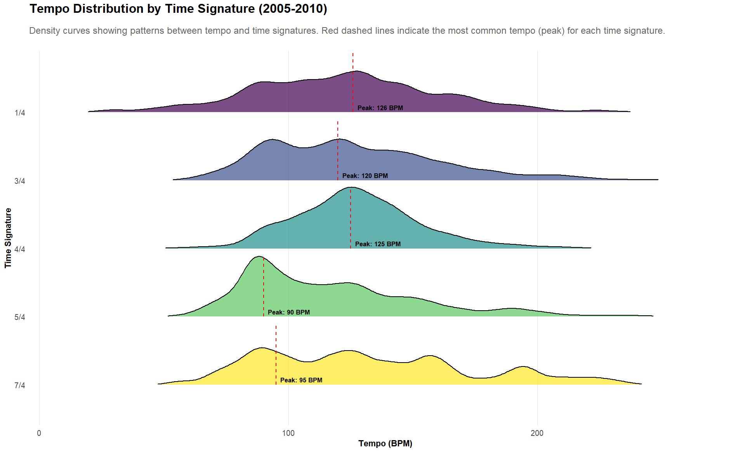
Notes:
Describe the message that you want to share with stakeholders from that plot:
This ridgeline plot shows a clear relationship between the time signatures and tempo usages among top artists. The red line reveals the highest tempo use of each The plot indicates signatures, 1/4, 3/4 and 4/4, commonly used 120~ BPM as the tempo while signatures , 5/7 and 7/7, are frequently used at 90~ BPM.
Why is this message will be important for stakeholders:
This plot is important because it shows the artists the unique relationship between time signature and bpm. This reveals standards techniques used by qualified artists and helps artists select or create songs with these combinations of time signatures and tempo.
What should stakeholders do as a result of seeing the plot:
Stakeholders should recommend these specific combinations to artists when they select or create their songs. Also, stakeholders should consider these combinations when design the theme and environment of the tempo and time signature.
Describe what steps taken so that the plot will have the most meaning and impact on stakeholders as possible.
To show identify relationship between time signature and tempo, the dataset by year, artist name and time To identify which artists to select, filter and group by artist name, extract sum of song hotness, reorder sum of song hotness to be in descending order, create rank with row number and boolean column to highlight the top 10 ranks.
Calculate most frequent number of artists’ time signature used by grouping time signature and extracting the tempo of the highest time signatures.
Visualise data using a ridgeline plot by time signature and average tempo. The plot matches the colours with the company’s colour scheme to enhance the appearance.
Added a line to highlight the tempo label of the most used time signature to provide further information of the specific trends.
For this key feature identified in the plot , describe how this feature links back to the main project:
This directly provides song features recommendations by identifying the current common combinations of tempo and time signatures. This ensures the songs performed produced the highest audience engagement and satisfaction.

Slide 18

Value for YOU?
Higher ticket sales through optimised artist/song selection.
Stronger sponsor appeal via data proven audience engagement insights.
Reduced risk of selecting not suitable candidates by aligning with industry success patterns.
Optimise songs and artists selection maximises crowd energy and repeat attendance.
These visualisations are extremely helpful for future artists and song selections.

Slide 19
Key Insights
Artist Selection
<50% average song hotness
Song Selection
Selected artists have all songs’ hotness are above 60%
Songs Features Adjustments
<60% average artist familiarity
<45% average artist hotness
Use 120~ BPM for 4/4, 3/4, 1/4
90~ BPM for 5/4 and 7/4
End in Fade-in: 0-1s
Suggested top four songs for each selected artist.
Artist familiarity should be considered first, song hotness second, and artist hotness third
Prioritise the selected artists’ songs with:
Prioritise artists with:
Suggested 10 artists by artist familiarity and cumulative song hotness
Most recommended:
Start of Fade out: 150s-225s
Loudness: -4dB to -8dB
Tempo: 100-150 BPM
Duration: : 150-225 seconds
Key: C, D and G
Time signature: 4/4
Consider the correlation between start of fade out and duration

Slide 20
Actions To Do
Step 1: Discuss the final artists choices and substitute artists choices
Step 2: Discuss the songs selection to suggest for the artists to perform.
Step 3: Discuss the songs features to recommend the artists to use..
Step 4: Discuss the concert location, marketing, staff members and sponsors
Step 6: Contact top 10 artists with recommended setlist and song features to consider
Step 5: Contact concert location, marketing, staff members and sponsors

Slide 21



What is Next
Goal: Gather customer feedback after the performance
Purpose: To validate the insights found has helped the artist and song selections by improving the audience experience. In addition, discover insights and opportunities to improve the artist and song selection process.
Methods: Post event surveys, social media sentiment and crowd behaviours, RFID wristbands
Data (1-5 scale): artist enjoyment, song recognition, overall energy levels, crowd density, etc

Slide 22
Future Project
Project: Visualising Customer Feedback
What It Looks Like:
Transform customer feedback into actionable to improve the selection process.
Visualisations:
Heatmap of customer feedback to identify correlations between the features in customer feedback for each song
Line plots of customer feedback features (crowd energy, crowd density) over the event duration, to identify patterns when the tempo, time signature and key changes.
Bar plots of the customer feedback features (e.g. enjoyment scales) and the artists/songs, to identify which artists/songs the audience enjoyed the most.

Slide 23
What We Would Do Differently:
Limitation | Approach | Impact
Limited historical data | Incorporate 2020-2024 trends to capture audience preferences. | Adjust artists and songs to match the modern audience preferences.
Limited song features | Analyse other song features from the original million song dataset such as energy, danceability, etc. | Gain different insights of the other song feature trends to enhance the analysis and improves the selection process.
Limited Visualisation | Expand visualisations such as use parallel coordinates plot to compare the multiple song features at the same time. | Reveals hidden patterns to enhance the analysis.
Limited Analysis | Used advanced analysis such as clustering such as group artists by specific song features | Gain deeper insights of the relationships in the data to enhance the analysis and improves the selection process.

